Slide 1
Efficacia del Neurofeedback nei pazienti Post-Chirurgia Bariatrica
Uno studio pilota
Dott.ssa Claudia Scaramuzzino
Phd Università degli studi magna graecia di catanzaro

Slide 2
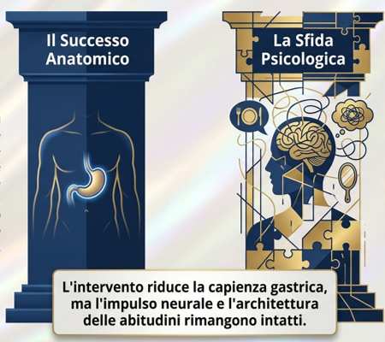
La Chirurgia Bariatrica rappresenta oggi il trattamento più efficace per l’obesità severa e per molte delle sue complicanze metaboliche.
Gli effetti positivi sono ben documentati: significativa perdita di peso, miglioramento del diabete, dell’ipertensione, delle apnee notturne e, più in generale, della qualità della vita.
Dopo l’intervento una parte dei paziente potrebbe continuare a presentare comportamenti alimentari disadattivi e difficoltà nella regolazione emotiva, compromettendo il mantenimento della perdita di peso a lungo termine
Hadipour Lakmehsari, A., Mento, C., Scaramuzzino, C., Arena, F., Turiaco, F., Muscatello, M. R. A., Navarra, G., Pandolfo, G., & Lombardo, C. (2025). Psychological Traits of Bariatric Surgery Candidates and Predictors of Outcomes. Journal of personalized medicine, 15(6), 215. https://doi.org/10.3390/jpm15060215
Sjöström, L. (2013). Review of the key results from the Swedish Obese Subjects (SOS) trial: A prospective controlled intervention study of bariatric surgery. Journal of Internal Medicine,
273(3),219–234.

Slide 3
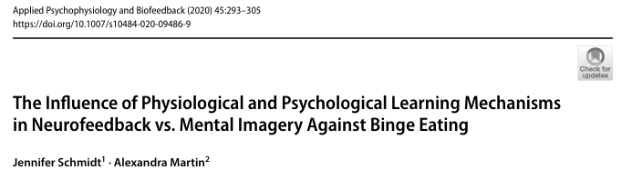
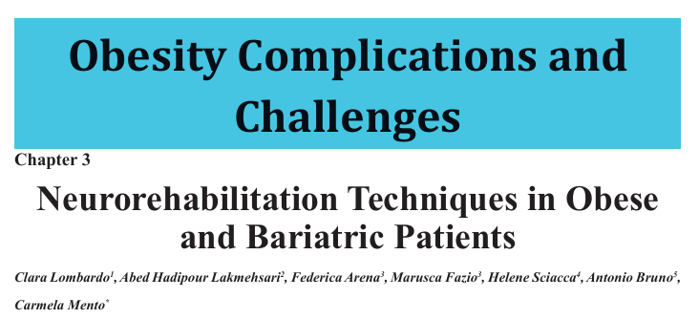
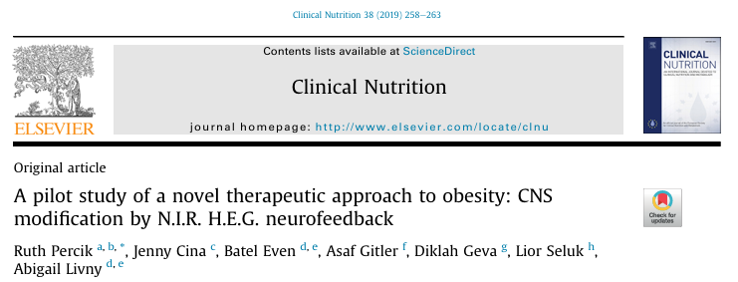
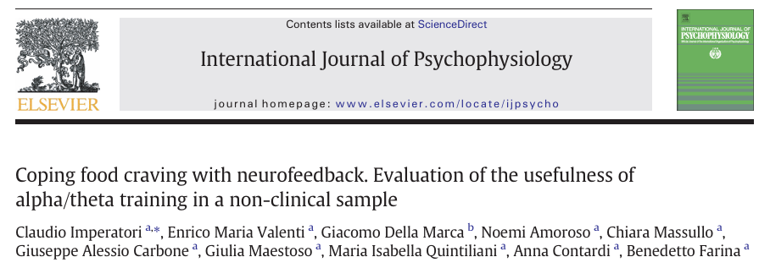


Slide 4
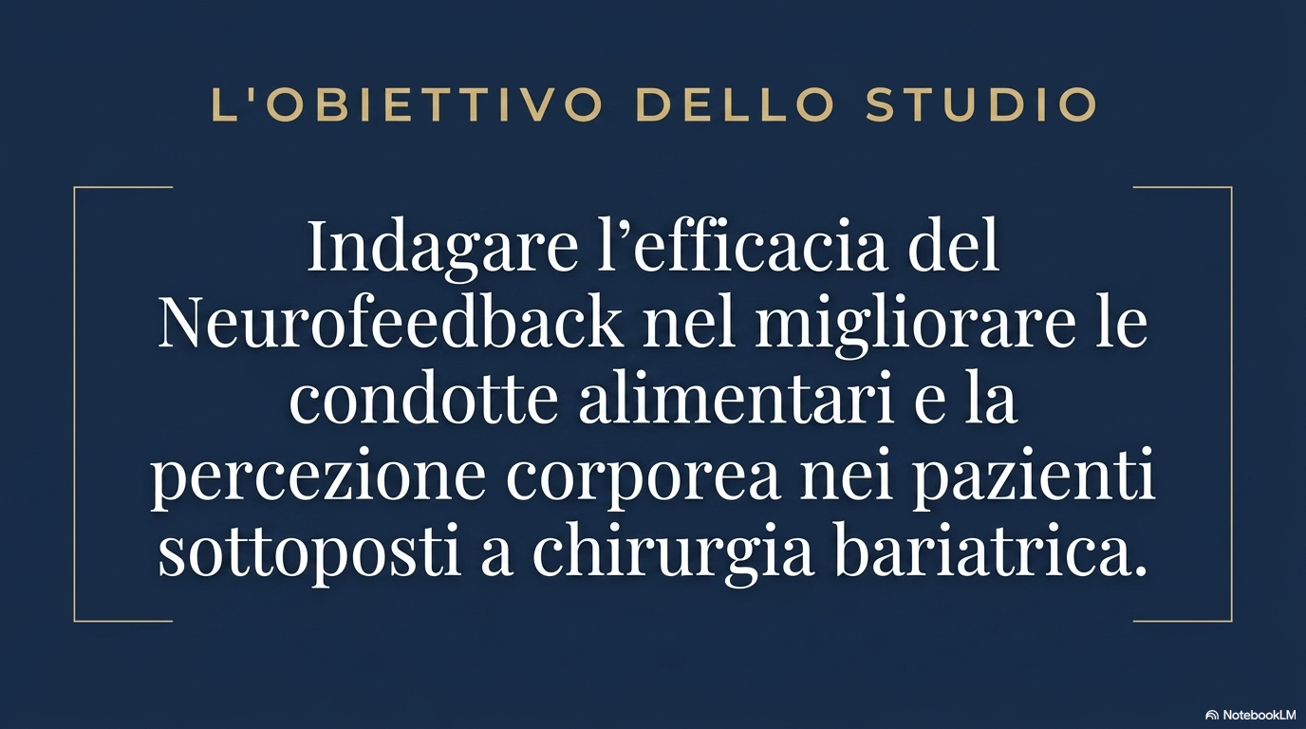

Slide 5
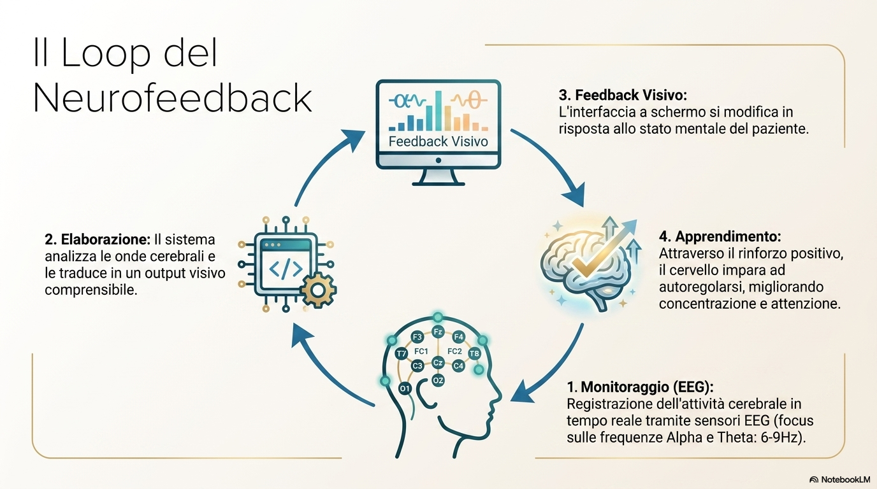
Egner, T., & Gruzelier, J. H. (2004). The Temporal Dynamics of Electroencephalographic Responses to Alpha/Theta Neurofeedback Training in Healthy Subjects. Journal of Neurotherapy, 8(1), 43–57.

Slide 6
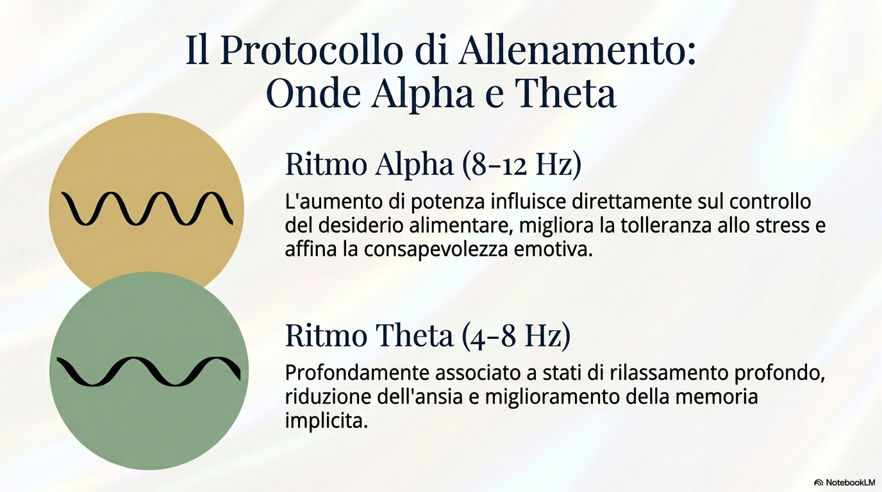
Imperatori, C., Valenti, E. M., Della Marca, G., et al., (2017). Coping food craving with neurofeedback. Evaluation of the usefulness of alpha/theta training in a non-clinical sample. International journal of psychophysiology : official journal of the International Organization of Psychophysiology,
Codispoti, M., De Cesarei, A., & Ferrari, V. (2023). Alpha-band oscillations and emotion: A review of studies on picture perception. Psychophysiology, 60(12), e14438. https://doi.org/10.1111/psyp.14438

Slide 7
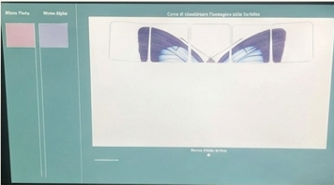
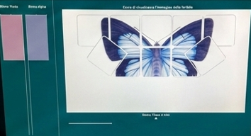
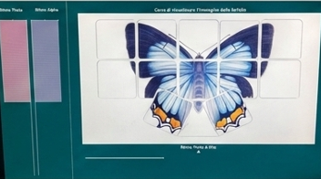
1. Il paziente non ha ancora raggiunto lo stato di rilassamento richiesto; il pattern Alpha/Theta risulta non ottimale e il feedback visivo appare frammentato.
2. Il paziente inizia progressivamente a modulare le frequenze cerebrali target. Parallelamente, il feedback visivo si ricompone gradualmente.
3. Il pattern Alpha/Theta raggiunge una configurazione più stabile e funzionale; il completamento dello stimolo visivo funge da rinforzo positivo, favorendo l’interiorizzazione dei pattern di autoregolazione.

Slide 8
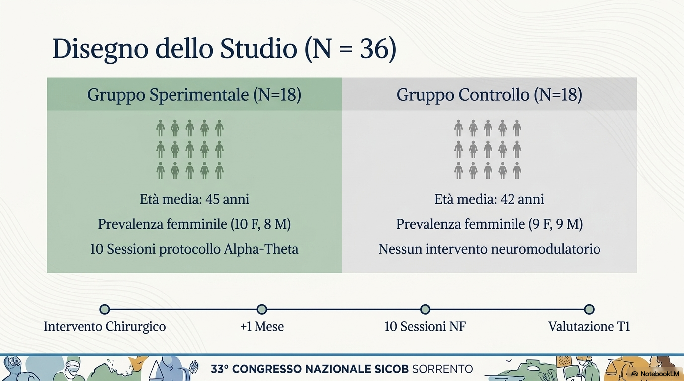

Slide 9
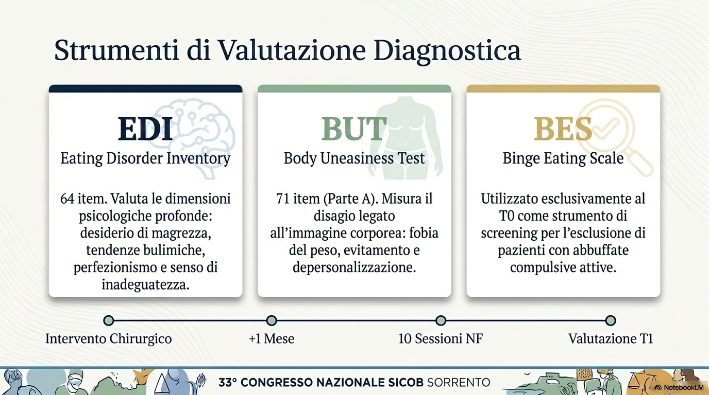
Schaefer, W. K., Maclennan, R. N., Yaholnitsky-Smith, S. A., & Stover, E. D. (1998). Psychometric evaluation of the Eating Disorder Inventory (EDI) in a clinical group. Psychology and Health,
Cuzzolaro, M., Vetrone, G., Marano, G., & Garfinkel, P. (2006). The Body Uneasiness Test (BUT): development and validation of a new body image assessment scale. Eating and Weight Disorders-Studies on Anorexia, Bulimia and Obesity
Gormally, J. I. M., Black, S., Daston, S., & Rardin, D. (1982). The assessment of binge eating severity among obese persons. Addictive behaviors

Slide 10
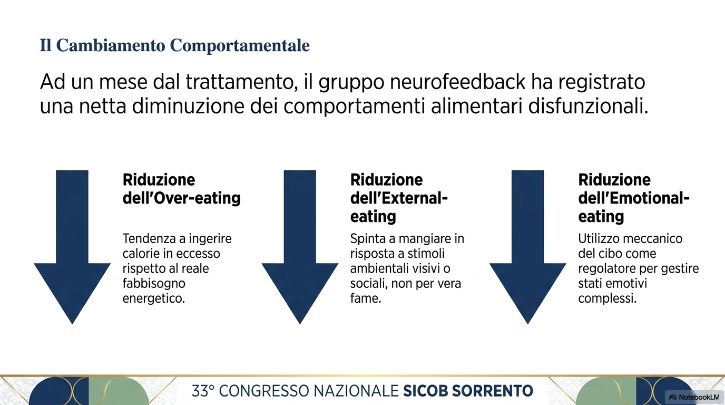
Wansink, B. (2004). Environmental factors that increase the food intake and consumption volume of unknowing consumers. Annual Review of Nutrition, 24, 455–479
Schachter, S. (1968). Obesity and eating: Internal and external cues differentially affect the eating behavior of obese and normal subjects. Science,
Arnow, B., Kenardy, J., & Agras, W. S. (1995). The Emotional Eating Scale: the development of a measure to assess coping with negative affect by eating. The International journal of eating disorders,

Slide 11
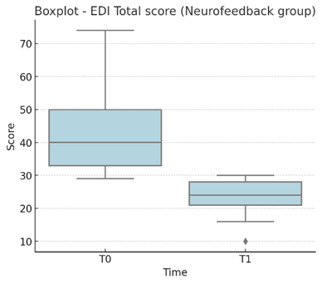
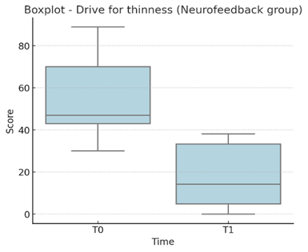
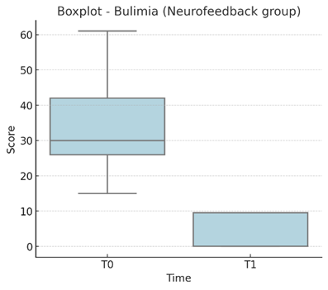
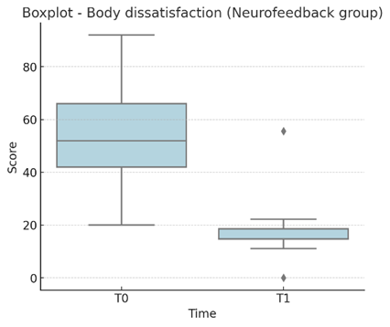
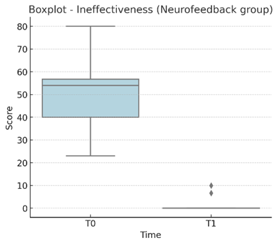
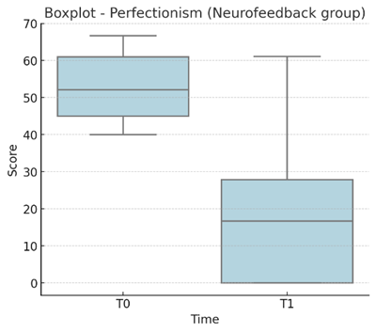
Boxplot Neurofeedback Group (T0 vs T1) EDI subscale:

Slide 12
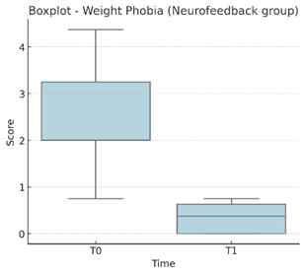
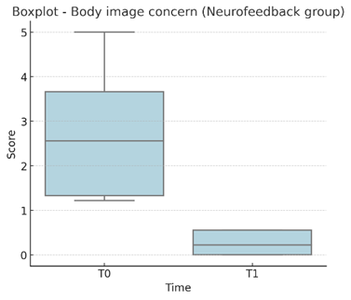
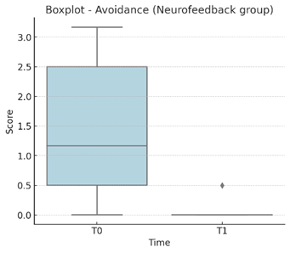
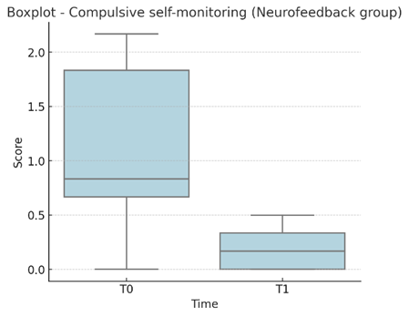
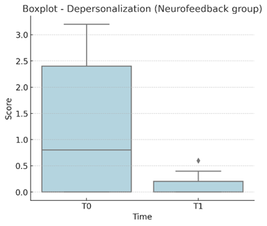
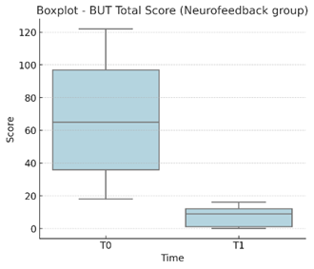
Boxplot Neurofeedback Group (T0 vs T1) BUT subscale:

Slide 13
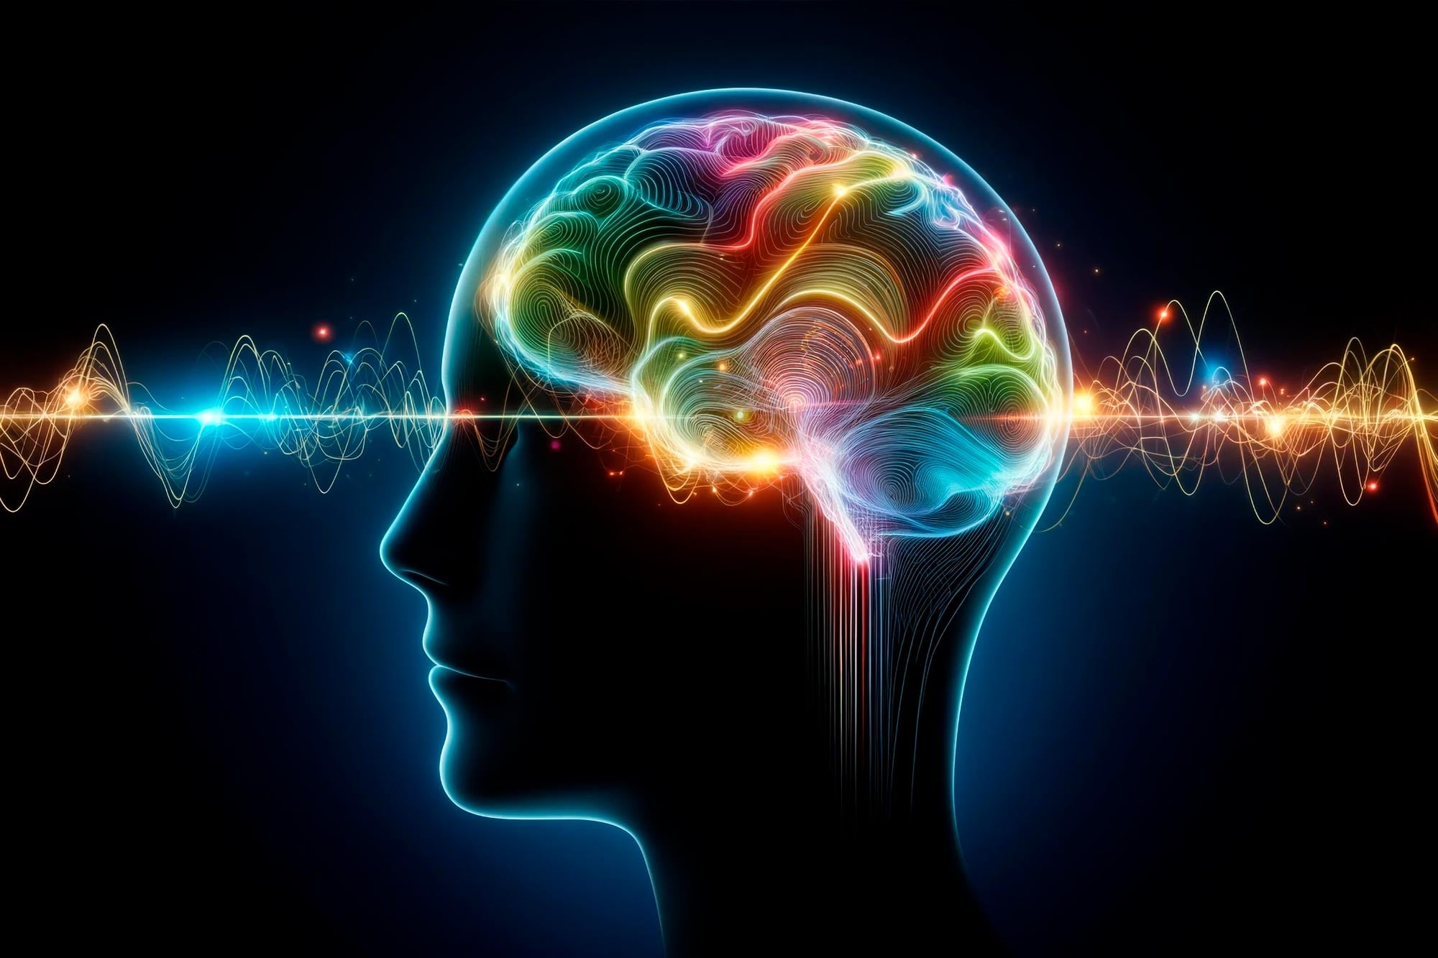
Conclusioni e implicazioni cliniche
La perdita di peso, rappresenta soltanto una parte del processo.
Il mantenimento dei risultati richiede adattamento, consapevolezza corporea, gestione dello stress e capacità di autoregolazione.
Il neurofeedback si è dimostrato uno strumento efficace nella gestione dei pazienti che si sono sottoposti ad un intervento di chirurgia bariatrica.
In futuro sarà necessario ampliare il campione e implementare follow-up a lungo termine per definire protocolli standardizzati nella pratica clinica

Slide 14
RIFERIMENTI BIBLIOGRAFICI
Arnow, B., Kenardy, J., & Agras, W. S. (1995). The Emotional Eating Scale: the development of a measure to assess coping with negative affect by eating. The International journal of eating disorders, 18(1), 79–90. https://doi.org/10.1002/1098-108X(199507)18:1
Codispoti, M., De Cesarei, A., & Ferrari, V. (2023). Alpha-band oscillations and emotion: A review of studies on picture perception. Psychophysiology, 60(12), e14438. https://doi.org/10.1111/psyp.14438
Cuzzolaro, M., Vetrone, G., Marano, G. et al. The Body Uneasiness Test (BUT): Development and validation of a new body image assessment scale. Eat Weight Disord 11, 1–13 (2006). https://doi.org/10.1007/BF03327738
Dalton, B., Campbell, I. C., & Schmidt, U. (2017). Neuromodulation and neurofeedback treatments in eating disorders and obesity. Current Opinion in Psychiatry, 30(6), 458–473. https://doi.org/10.1097/YCO.0000000000000361
Egner, T., & Gruzelier, J. H. (2004). The Temporal Dynamics of Electroencephalographic Responses to Alpha/Theta Neurofeedback Training in Healthy Subjects. Journal of Neurotherapy, 8(1), 43–57. https://doi.org/10.1300/J184v08n01_04
Gormally, J., Black, S., Daston, S., & Rardin, D. (1982). The assessment of binge eating severity among obese persons. Addictive Behaviors, 7(1), 47–55. https://doi.org/10.1016/0306-4603(82)90024-7
Hadipour Lakmehsari, A., Mento, C., Scaramuzzino, C., Arena, F., Turiaco, F., Muscatello, M. R. A., Navarra, G., Pandolfo, G., & Lombardo, C. (2025). Psychological Traits of Bariatric Surgery Candidates and Predictors of Outcomes. Journal of personalized medicine, 15(6), 215. https://doi.org/10.3390/jpm15060215
Imperatori, C., Valenti, E. M., Della Marca, G., et al., (2017). Coping food craving with neurofeedback. Evaluation of the usefulness of alpha/theta training in a non-clinical sample. International journal of psychophysiology : official journal of the International Organization of Psychophysiology, 112, 89-97. https://doi.org/10.1016/j.ijpsycho.2016.11.010
Mento, C. Neurorehabilitation techniques in obese and bariatric patients. In: Introduction Following World Obesity Day. Neurorehabilit. Tech. Obes. Bariatr. 2022, 1, 41–51.
Percik, R., Cina, J., Even, B., Gitler, A., Geva, D., Seluk, L., & Livny, A. (2019). A pilot study of a novel therapeutic approach to obesity: CNS modification by N.I.R. H.E.G. neurofeedback. Clinical Nutrition, 38(1), 258–263. https://doi.org/10.1016/j.clnu.2018.01.023
Schachter, S. (1968). Obesity and eating: Internal and external cues differentially affect the eating behavior of obese and normal subjects. Science, 161(3843), 751–756. https://doi.org/10.1126/science.161.3843.751
Schaefer, W. K., Maclennan, R. N., Yaholnitsky-Smith, S. A., & Stover, E. D. (1998). Psychometric evaluation of the Eating Disorder Inventory (EDI) in a clinical group. Psychology and Health, 13 (5), 873–881. https:// https://doi.org/10.1080/08870449808407437
Schmidt, J., & Martin, A. (2020). The Influence of Physiological and Psychological Learning Mechanisms in Neurofeedback vs. Mental Imagery Against Binge Eating. Applied psychophysiology and biofeedback, 45(4), 293–305. https://doi.org/10.1007/s10484-020-09486-9
Sjöström, L. (2013). Review of the key results from the Swedish Obese Subjects (SOS) trial: A prospective controlled intervention study of bariatric surgery. Journal of Internal Medicine, 273(3), 219–234. https://doi.org/10.1111/joim.12012
Wansink, B. (2004). Environmental factors that increase the food intake and consumption volume of unknowing consumers. Annual Review of Nutrition, 24, 455–479 https://doi.org/10.1146/annurev.nutr.24.012003.132140

Slide 15
Grazie per l’attenzione
Dott.ssa Claudia Scaramuzzino
Phd Università degli studi magna graecia di catanzaro

